Slide 1
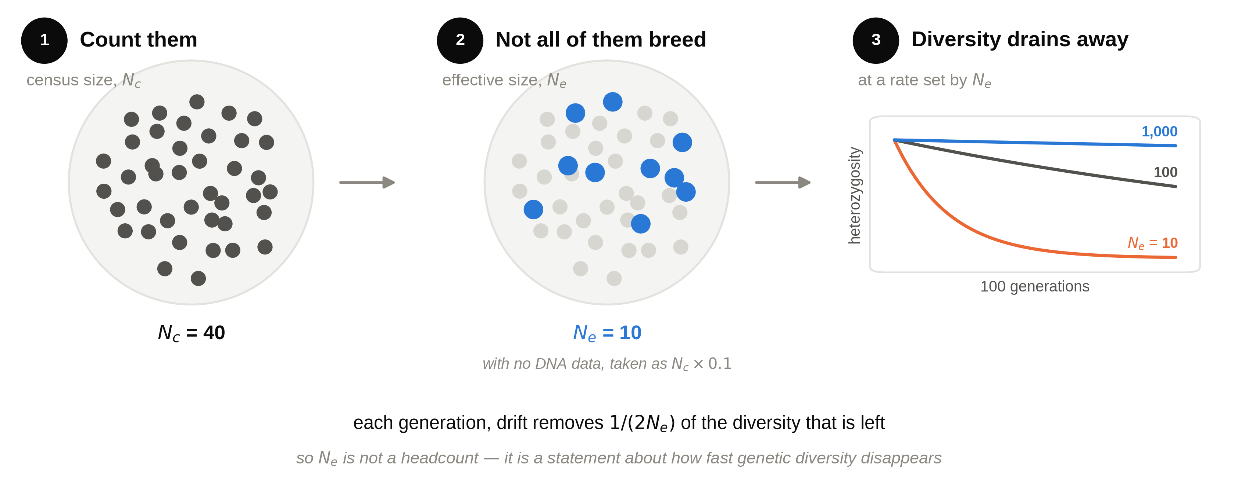
Ne: how fast a population loses its genetic diversity

Slide 2
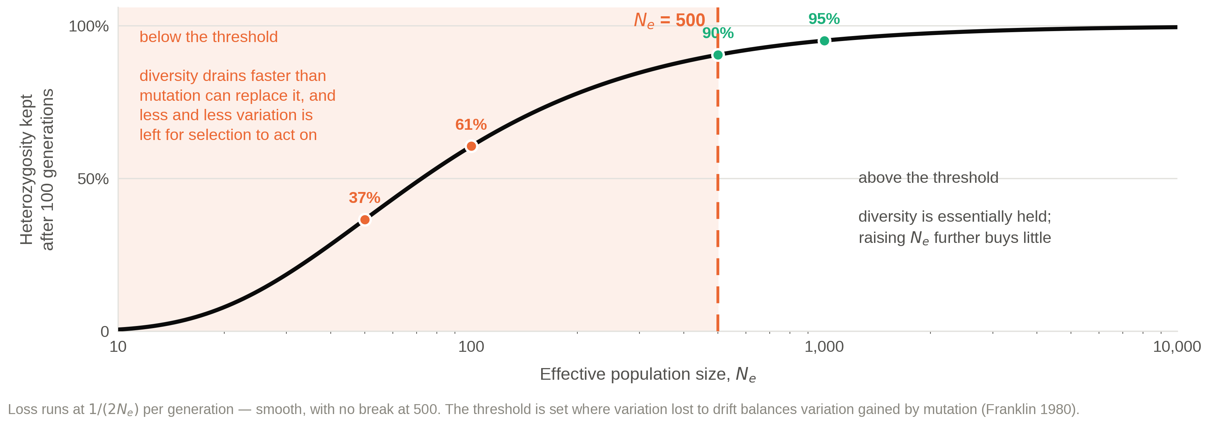
Below Ne 500, a population cannot hold what it has
The threshold was set for a population sitting still.
It says nothing about what these populations actually have to adapt to — so that is what I model.

